Slide 1

Modified Cornell Method
Another Look

Slide 2
Why require students to take notes?
To improve critical reading and writing skills
To enrich class discussion
To promote student engagement
To improve classroom environment
To make students accountable for their own learning

Slide 3
From Writing to Knowing
Note taking is an act of translation.
Students write new ideas/concepts in their own words—an exercise in understanding.
Generating questions afterward forces students to think about the connections and implications of new concepts.

Slide 4
Active vs. Passive Learning
Characteristics of Passive & Active Learners
 | Passive | Active
Class lectures | Write down what the Instructor says | Decide what is important to write down
Textbook Assignments, Studying | Read Reread | Read, think, ask questions, try to connect ideas
Writing, Class Assignments | Carefully follows the professor’s instructions | Try to discover the significance of the assignment; look for the principles and concepts it illustrates
Writing, Class Assignments | Do what is expected to get a good grade | Make outlines and study sheets, look for trends and patterns.
Writing term papers | Do what is expected to get a good grade | Try to expand your knowledge and experience with a topic and connect it to the course objective or content
Source: Study and Critical Thinking Skills in College, McWhorther, K.T., 1996. p. 14.

Slide 5
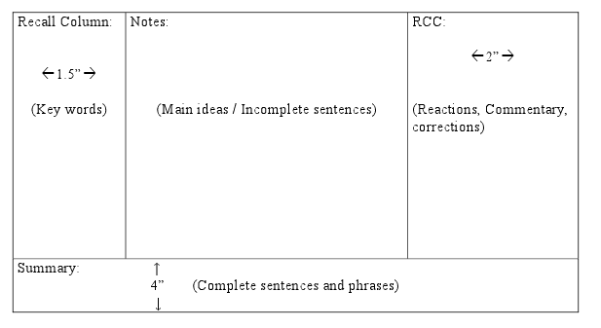
Modified Cornell Note Taking
Notes or Note Taking Area:
  Record class discussion or key text information here.
  Use abbreviations for speed but try to record notes as fully as possible.
Recall or Cue Column:
  Reduce notes to cues: key terms, questions, and clues.
Summary Box:
  Summarize the notes on the page in one or two sentences.
RCC Column:
  Think and ponder. Take time to think about the topic, relationships, and importance of the information.

Slide 6
Basic Format for Cornell Note Taking
KEY IDEAS OR QUESTIONS
BASED ON NOTES:
NOTE TAKING AREA:
(Step #1)
*Take notes here first, just like
you would normally do…with
abbreviations, short phrases,
etc.
(Step #2)
*After you’ve finished all your
note taking, then you create
questions that your notes
answer.
(Step #3)
*Jot down questions or
add information that
will help you understand the
notes better. Write
down your own reactions
or insights about the concepts.
Add pictures or graphics
that help summarize,
organize or explain the main
Concepts.
*Each pg. of notes should
have at least 3-4 questions
in this column.
SUMMARY:
*Lastly, you write a summary of the main
(Step #4)
ideas in your notes for each page.

Slide 7
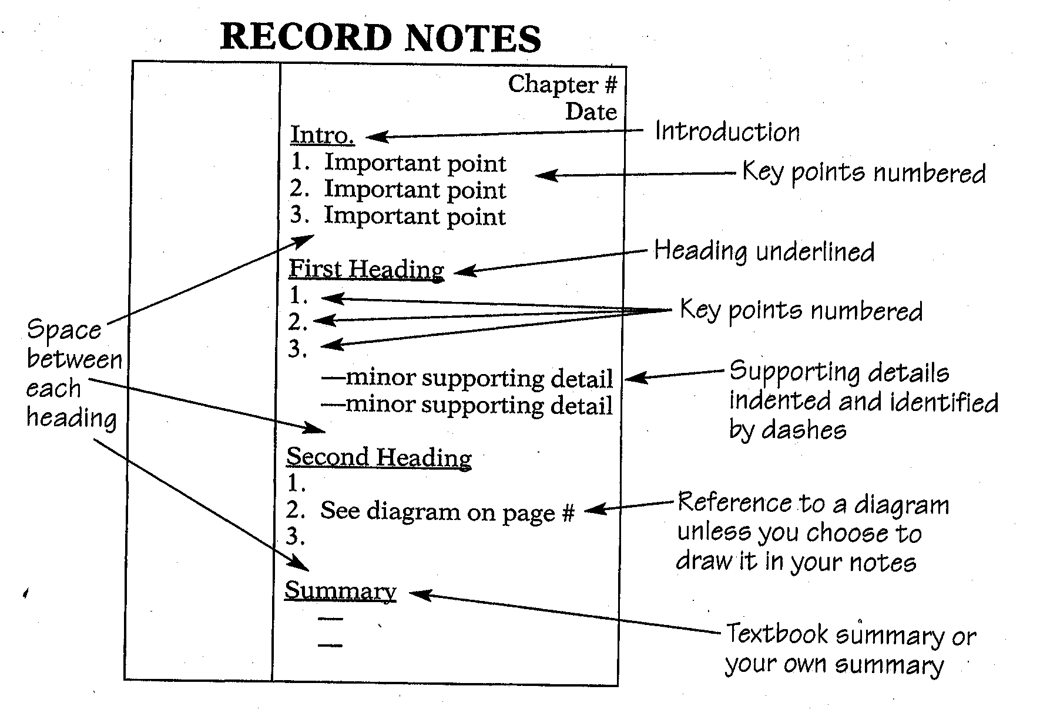

Slide 8
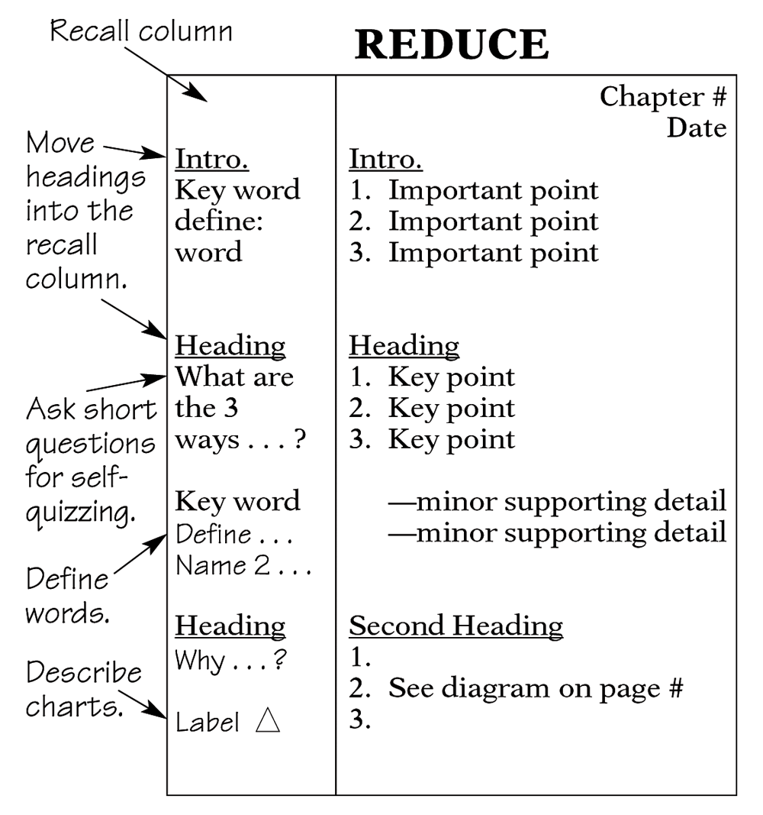
Cornell Reduce Step

Slide 9
Types of Information to Include
Topic Topic Problem | Source Definition Steps / Solution | Source 2 Example Example / Amplification
Summary

Slide 10
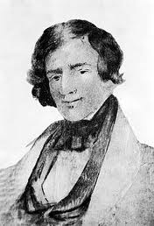
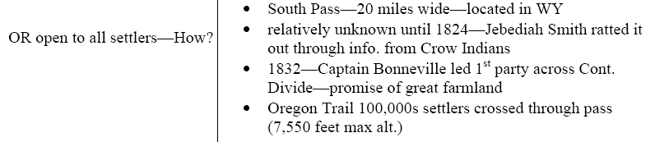
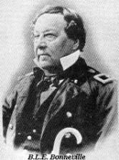
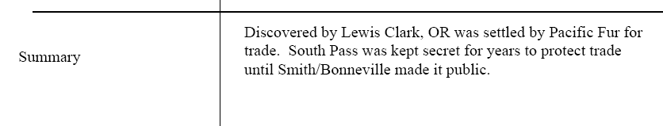
Sample Reading Notes
See my notes from
High School AP History
Class.
*Should find a map.

Slide 11
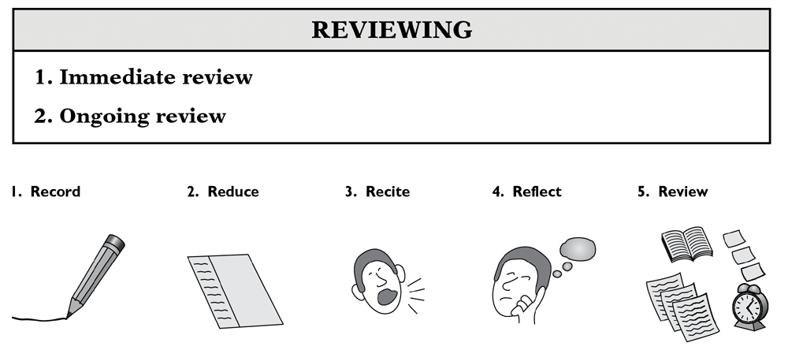
Cornell: Review Step

Slide 12
How do we forget?
Forgetting curve would start here if we could remember everything after a lecture
However, you have the potential to forget less PLUS remember more if you review immediately after class
Forgetting curve would actually start here as we typically remember only about 75% at the end of a lecture – so we have less to remember

Slide 13
Overcoming the Curve
Immediately after class
24 hours later
1 week later (or sooner)
1 month later (or sooner)
Notice how less is forgotten after each review!!

